Slide 1


Green Pace
Security Policy Presentation
Developer: Kalin A. Mason

Slide 2

OVERVIEW: DEFENSE IN DEPTH
This security policy is intended to outline coding standards and principles that can be utilized by all employees. This will be achieved by following security policies such as Triple-A framework and Defense in Depth.

Slide 3
THREATS MATRIX
Likely STR-51-CPP STR-02-C MEM-50-CPP | Priority EXP-50-CPP
Low priority ERR-50-CPP ERR-51-CPP | Unlikely STD-001-CPP DCL-03-C MSC-50-CPP STR-53-CPP

Slide 4
10 PRINCIPLES
Validate Input Data
STR-51-CPP
STR-53-CPP
Heed Compiler Warnings
ERR-51-CPP
Architect and Design for Security Policies
DCL-51-CPP
EXP-50-CPP
MEM-50-CPP
MSC-50-CPP
Keep It Simple
ERR-50-CPP
Default Deny
Adhere to the Principle of Least Privilege
Sanitize Data Sent to Other Systems
STR-02-C
Practice Defense in Depth
Use Effective Quality Assurance Techniques
DCL-03-C
Adopt a Secure Coding Standard

Slide 5
CODING STANDARDS
STR-51-CPP | Likely
STR-02-C | Likely
MEM-50-CPP | Likely
EXP-50-CPP | Probable
ERR-51-CPP | Probable
ERR-50-CPP | Probable
DCL-03-C | Unlikely
MSC-50-CPP | Unlikely
STR-53-CPP | Unlikely
STD-001-CPP | Unlikely

Slide 6
ENCRYPTION POLICIES
In Use
This is data that is used by the application, such as data currently used by a user or logging into a system
At Rest
Data that is being stored or currently not in user should be encrypted and kept separate from the rest of the application
In Flight
Data that is in transit, which could be moving between components or being utilized by a 3rd party source

Slide 7
TRIPLE-A POLICIES
Authentication
Verification for users and connections to the application. Technologies like MFA (multifactor authentication) and whitelisted devices will be beneficial.
Authorization
Verify users have correct privileges while using the application or system. Least privilege for users to complete their tasks. Limiting read, write, delete to the appropriate users.
Accounting
Log all tasks; users logging in, data access, activities, etc. Creating log files are useful for diagnosing any security issues in the system.

Slide 8
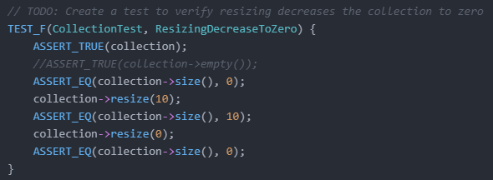
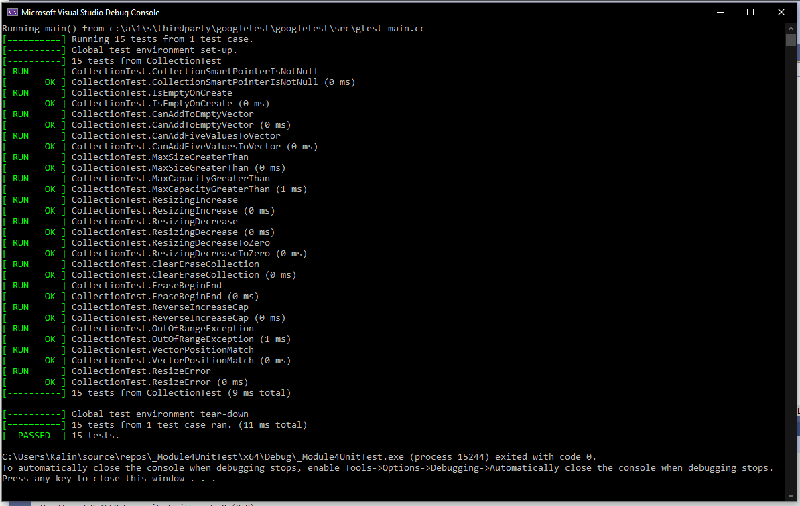
Unit Testing- MEM50-CPP
Memory management is essential in C++ for all systems. This unit test verified the resizing decreased the collection to zero. This was essential in ensuring the size of the collection was reduced and didn’t create any UB.

Slide 9

AUTOMATION SUMMARY

Slide 10
TOOLS
DevSecOps builds onto the current SDLC (Software Development Life Cycle) by focusing on security techniques and standards from the beginning. To ensure a smooth operation, this is focused on through designing, building, testing, and through production and maintenance.
Clang and Astree can assist with the “Verify and Test” phase of the process. While external tools can assist with ensuring the functionality, ensure all code follows the security policies, and detecting vulnerabilities in dependencies.

Slide 11
RISKS AND BENEFITS
Lacking encryption and automation
Act now
Fewer risks in production
Securer code with standardized practices
Larger initial cost and effort
Wait
More difficult to maintain
Can be costly to fix or maintain if issues arise post production
Smaller initial cost and effort

Slide 12
RECOMMENDATIONS
Triple-A Framework
Authenticating is important
MFA (multi-factor authentication) is a tool/technology that can be used in almost all applications to ensure that authentication is checked in multiple forms for users
Encrypt everything
Unit testing
Tools to check vulnerabilities

Slide 13
CONCLUSIONS
Increased focus should be placed on standards that focus on strings, buffers, and memory management when developing C++ code.
The accounting piece of Triple-A frameworks should be especially considered. Malicious intent and users are inevitable, and we should prepare by being able to record all information regarding vulnerabilities.

